Slide 1
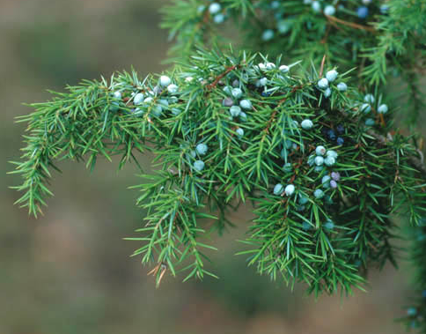
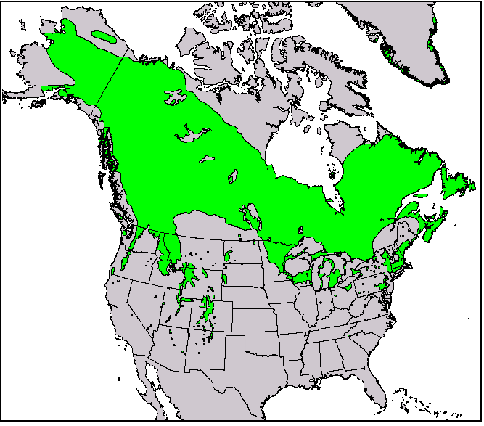
Species geographical ranges
Spatial area over which populations of a given species are found
Species: Juniperus communis
Name: common juniper

Slide 2
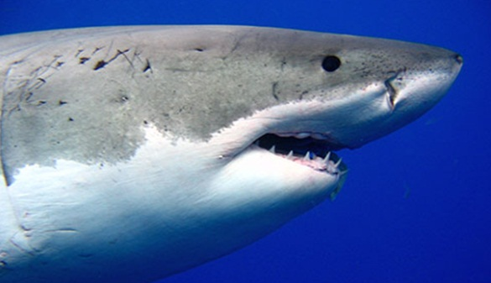
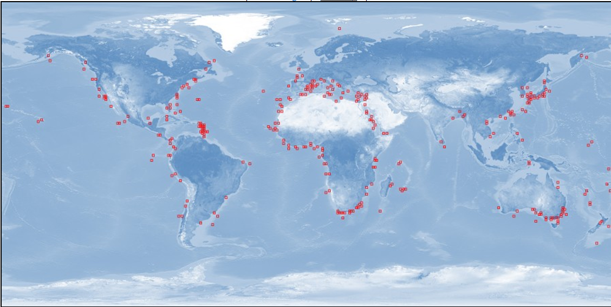
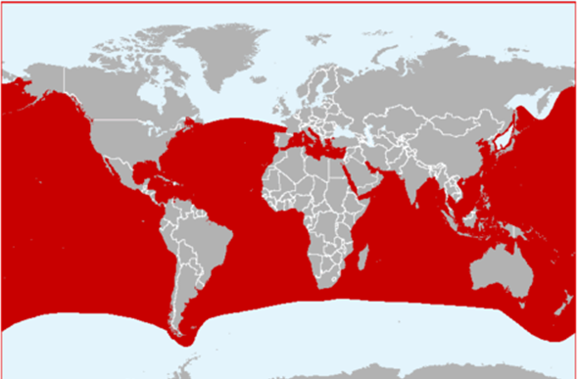
What exactly do we mean by species ranges: the data
Extent of occurrence: area which lies within the outermost geographic limits to the occurrence of a species
Area of occupancy: area within those outermost limits over which it actually occurs.
Species: Carcharodon carcharias
Name: Great white shark
Raw data: where individuals have been found
Range: area where individuals can be found
www.iobis.org
www.iucnredlist.org/

Slide 3
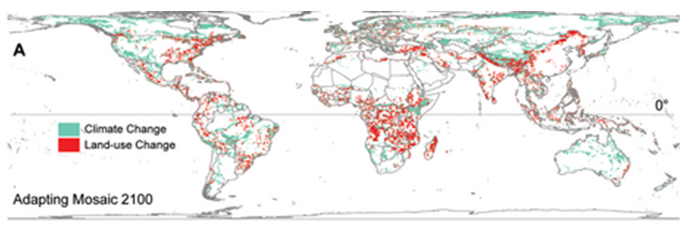
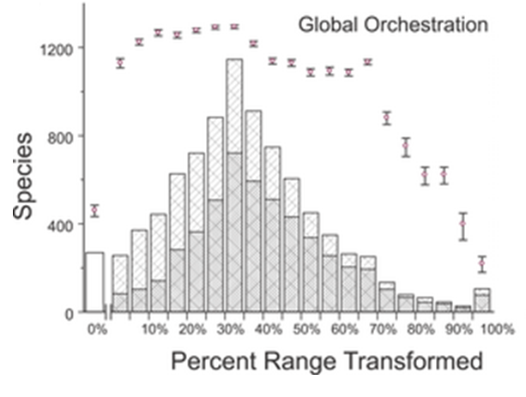
Why is range size important?
Projected changes in habitats
Allow to quantify extinction risk
Jetz et al., PlosBiology 2007

Slide 4
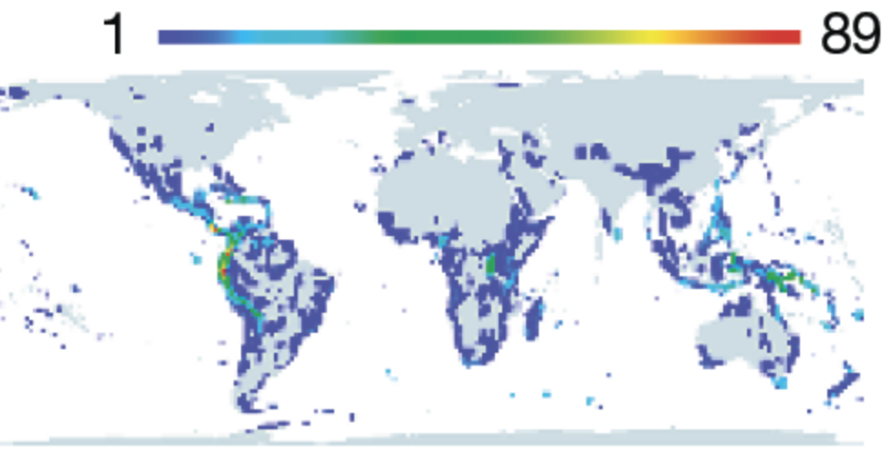
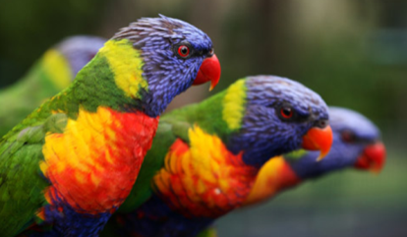
Why is range size important?
Identify areas of vulnerability
Distribution of species with small ranges
Grenyer et al., Nature 2007

Slide 5
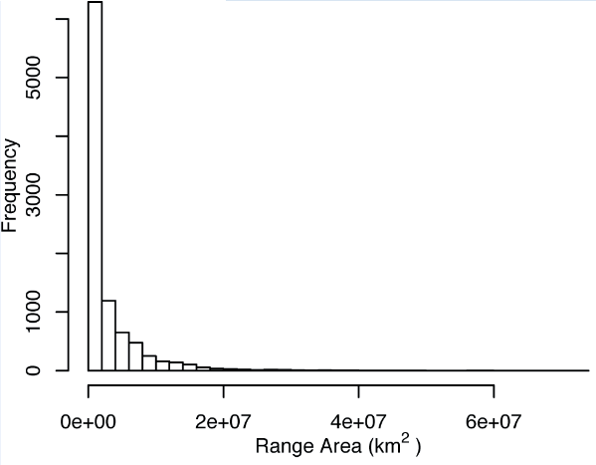
Key questions
What shapes the range size frequency distribution?
Why a species has the range it does?
Species: Juniperus communis
Name: common juniper
Orme et al., PlosBiology 2006

Slide 6
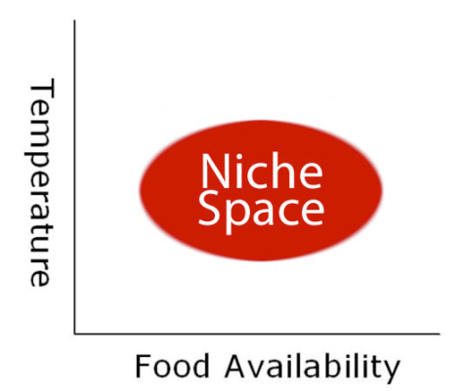
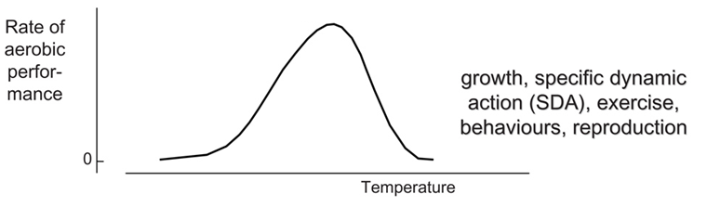
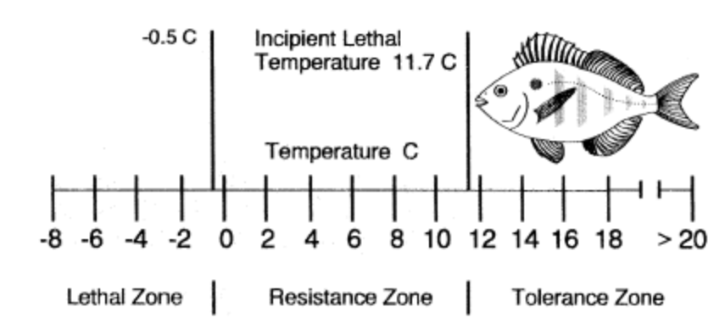
: niche theory
Why a species has the range it does?
Range is set by environmental and ecological constraints imposed to species tolerances
Bennett & Judd, Copeia 1992

Slide 7
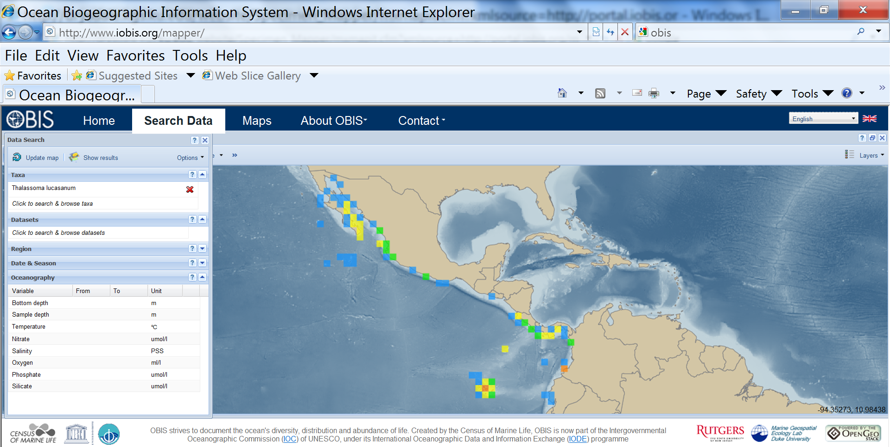
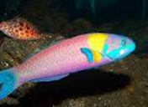
Why a species has the range it does?: niche theory
However the environmental envelope is not the whole story
Records where this species has been found
Species: Thalassoma lucasanum
Name: Grasse

Slide 8
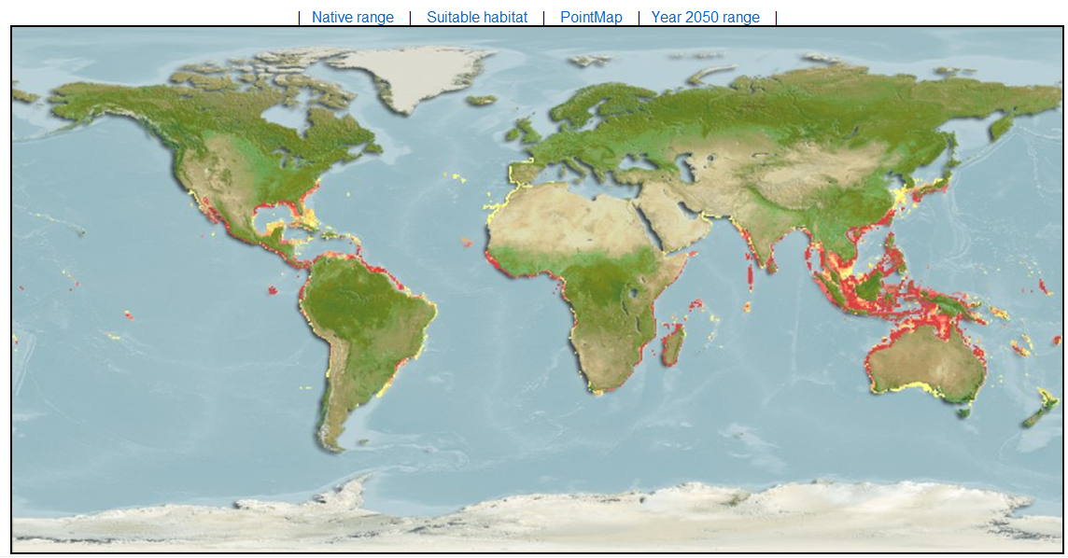
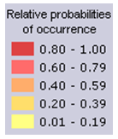
Why a species has the range it does?: niche theory
Environment alone does not explain species ranges
Species: Thalassoma lucasanum
Name: Grasse

Slide 9
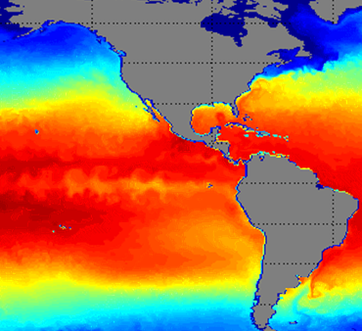

Why a species has the range it does?: niche theory
Another more specific example: Temperature
Species: Thalassoma lucasanum
Name: Grasse
Tolerance: 16 ºC
Ranges appear to be constrained by something else other than temperature

Slide 10
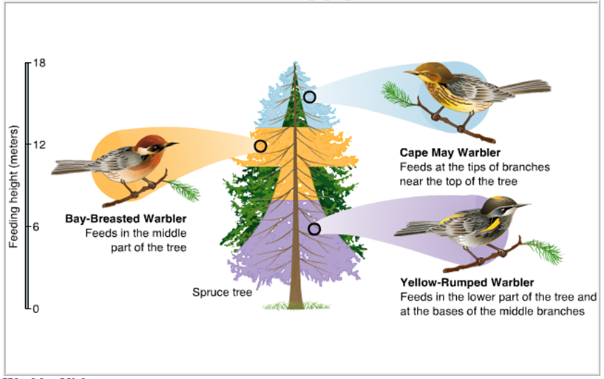
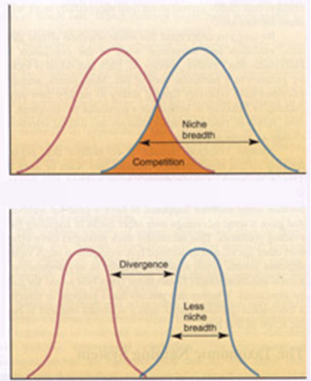
Why a species has the range it does?: niche theory
Ecological factors
Abundance
Resource gradient
While ecological interactions may explain local distribution of species, there is little evidence supporting that ecological interactions set species range boundaries
The struggle for survival forces species to co-exists one way or another

Slide 11
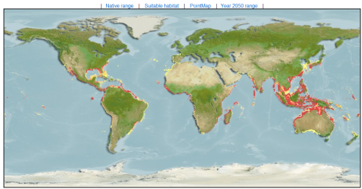
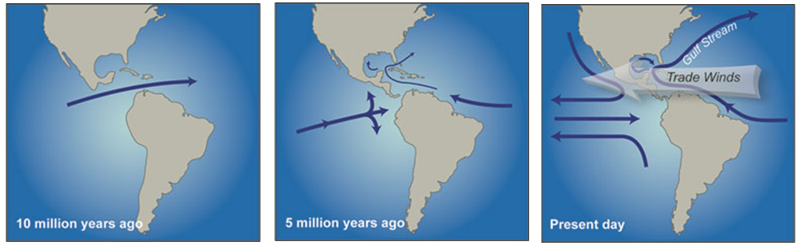
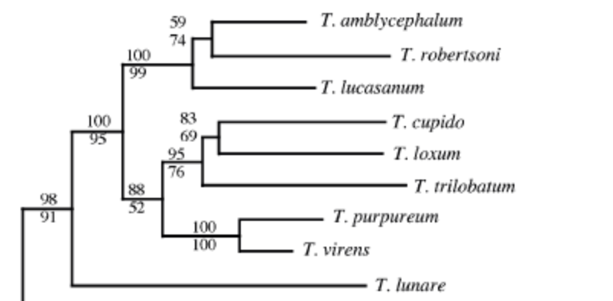
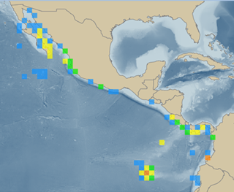
Why a species has the range it does?: evolution
Species: Thalassoma lucasanum, Name: Grasse
Evolution explains well why some species are not found in certain places
~3 million years ago
Bernardi et al Marine Biology 2004

Slide 12

Why a species has the range it does?: Transport
Gaylord & Gaines, American Naturalist 2000
California
Current
Atlantic
Ocean
Pacific
Ocean
Why it is not here?
Indian
Ocean
Peruvian
Current
Species: Thalassoma lucasanum, Name: Grasse, Tolerance: 16 C
Currents explains well why some species are not found in certain places

Slide 13
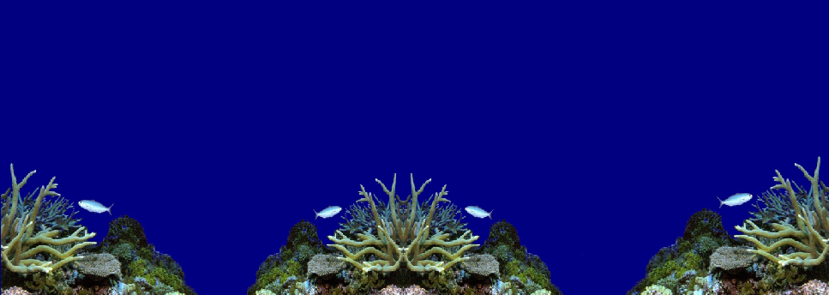
Why a species has the range it does?: dispersal
The life cycle of most marine organisms
Larvae
Species with larger dispersal capabilities should have larger ranges
Eggs

Slide 14
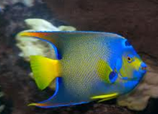
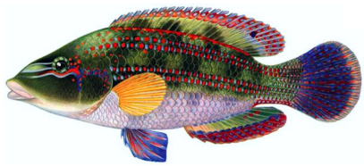
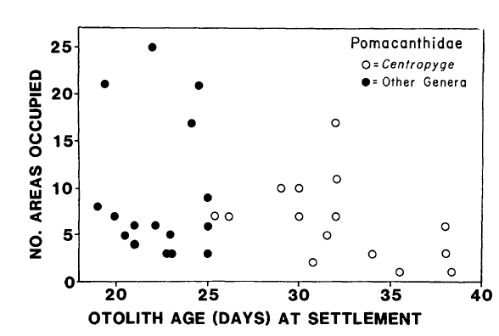
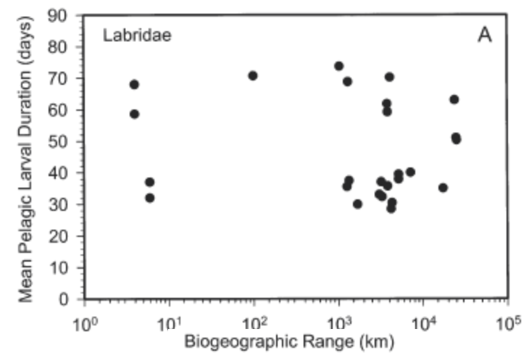
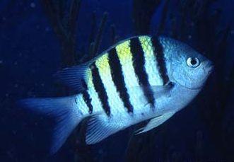
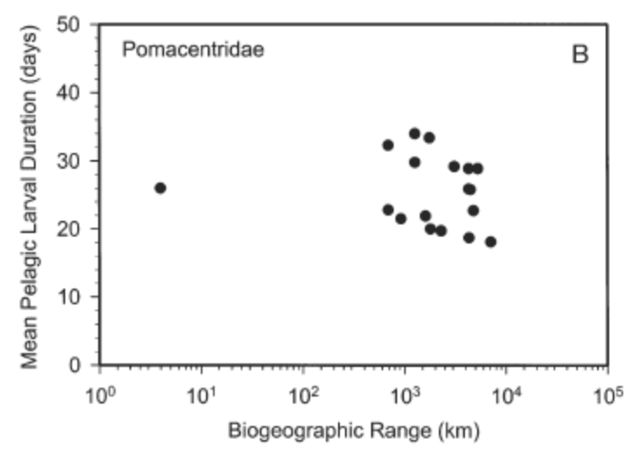
Why a species has the range it does?: dispersal
Pelagic Larval Duration
Victor & Wellington MEPS 2000
Trhesher & Brother, Evolution 1985
Victor & Wellington MEPS 2000
NO EFFECT

Slide 15
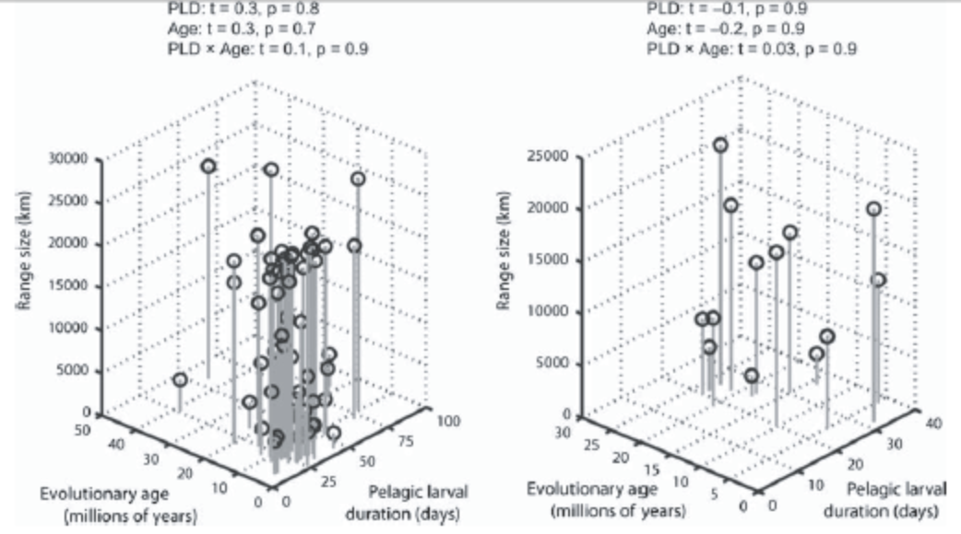


Why a species has the range it does?: dispersal why not?
Evolutionary age effect
Older species larger ranges
Bernardi et al Marine Biology 2004
NO EFFECT EITHER
Mora et al., Ecography 2011

Slide 16
Why a species has the range it does?: why not dispersal?
Isolation effect
What is isolation?: how difficult is to reach a habitat
Atlantic
Ocean
Pacific
Ocean
Indian
Ocean

Slide 17
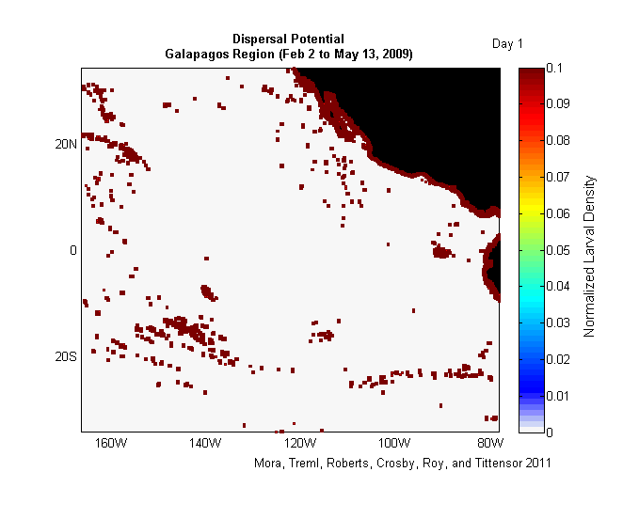
Why a species has the range it does?: dispersal why not?
Isolation effect: assumption
For dispersal to have an effect on range size, habitats need to be isolated along a gradient of isolation only to be overcome depending upon species dispersal capabilities.
Isolation
Dispersal
Is this assumption true?
Habitat

Slide 18
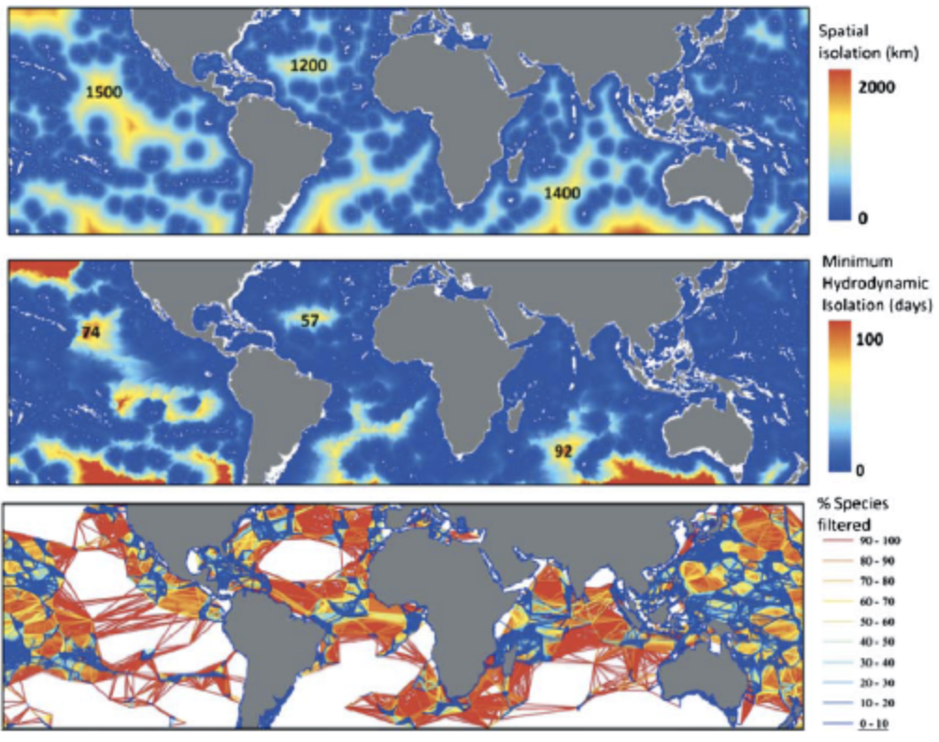
Why a species has the range it does?: dispersal why not?
There seems to be no isolation is the world’s reefs
Explains
Why dispersal does not relate to range size
Do not explain
Why species have the range they have?
Mora et al. Ecography 2011

Slide 19
Why a species has the range it does?
We are not fully certain

Slide 20
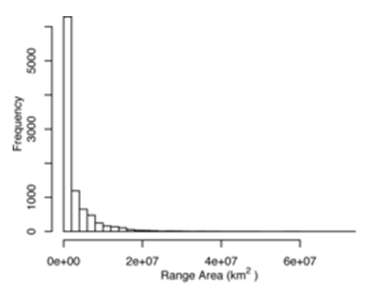
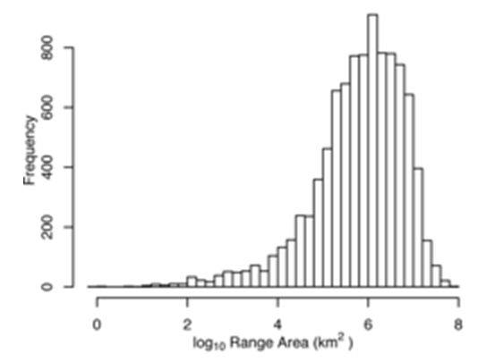
What shapes the range size frequency distribution?
Orme et al., PlosBiology 2006

Slide 21
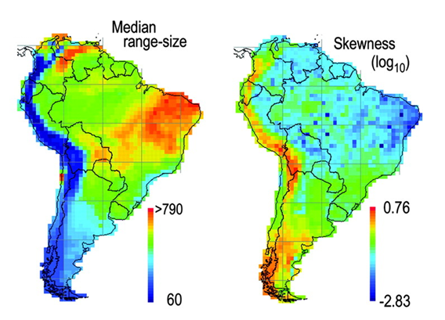
The pattern is variable
Graves G R , Rahbek C PNAS 2005

Slide 22
Why this shape?
Multiple explanations
Gaston Proc. Roy. Soc. London 1998
Speciation
Extinction
Effect
Dispersal Effect

Slide 23
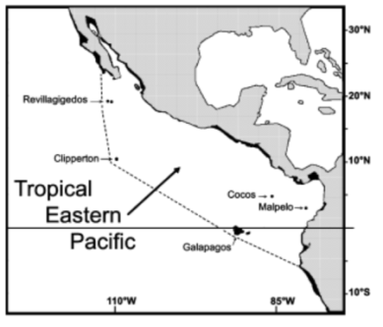
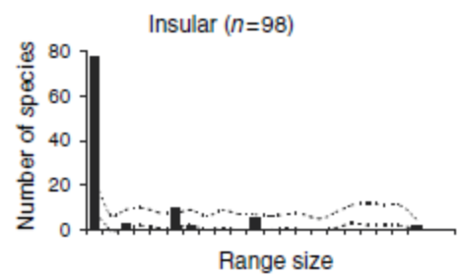
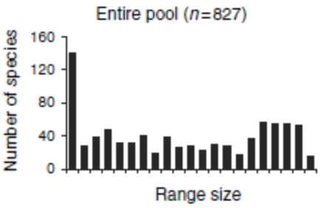
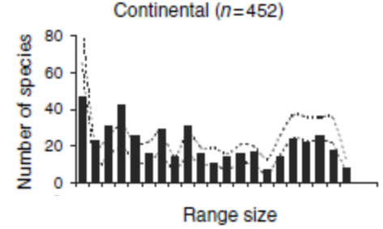
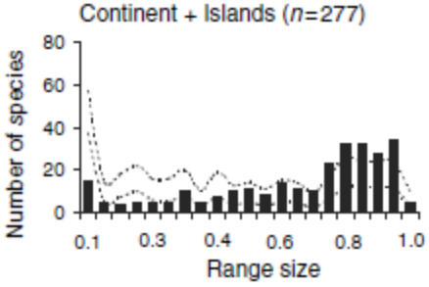
Dispersal and isolation alone (Mora and Robertson)
Mora & Robertson, J. Biogeography 2005

Slide 24
In summary
Environmental tolerances
Ecological interactions
Niche
Individual species
?
Evolution
Dispersal
Range sizes are variable
Speciation
Extinction
All species combined
Transformation
Dispersal and
isolation

